Slide 1
Information Session
Sunshine Coast Schools Mooting Competition
Leon Harris
Clinical Legal Educator

Slide 2
Objectives for this session
Learn about Mooting
Learn about the Sunshine Coast Schools Mooting Competition

Slide 3

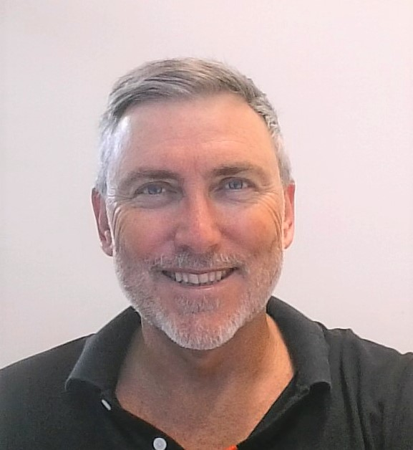
Moot Convenor
Leon Harris
Clinical Legal Educator - UniSC
highschoolmooting@usc.edu.au or
lharris@usc.edu.au

Slide 4
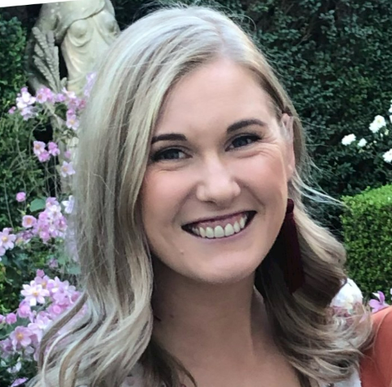
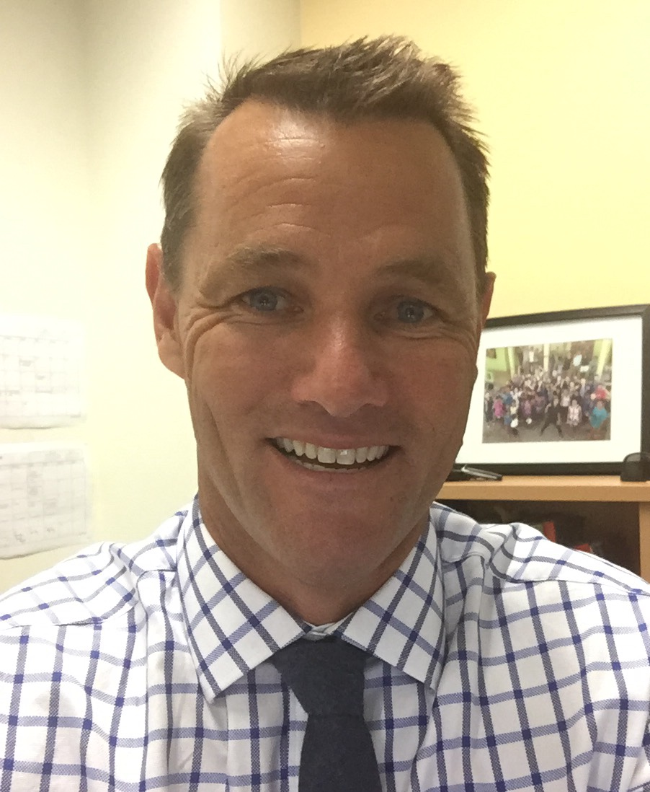
Schools Co-ordinators
Caitlin Brown
Sunshine Coast Grammar School
cbrown@scgs.qld.edu.au
07 5445 4444
Ben Princehorn
Sunshine Coast Grammar School
bprincehorn@scgs.qld.edu.au
07 5445 4444

Slide 5
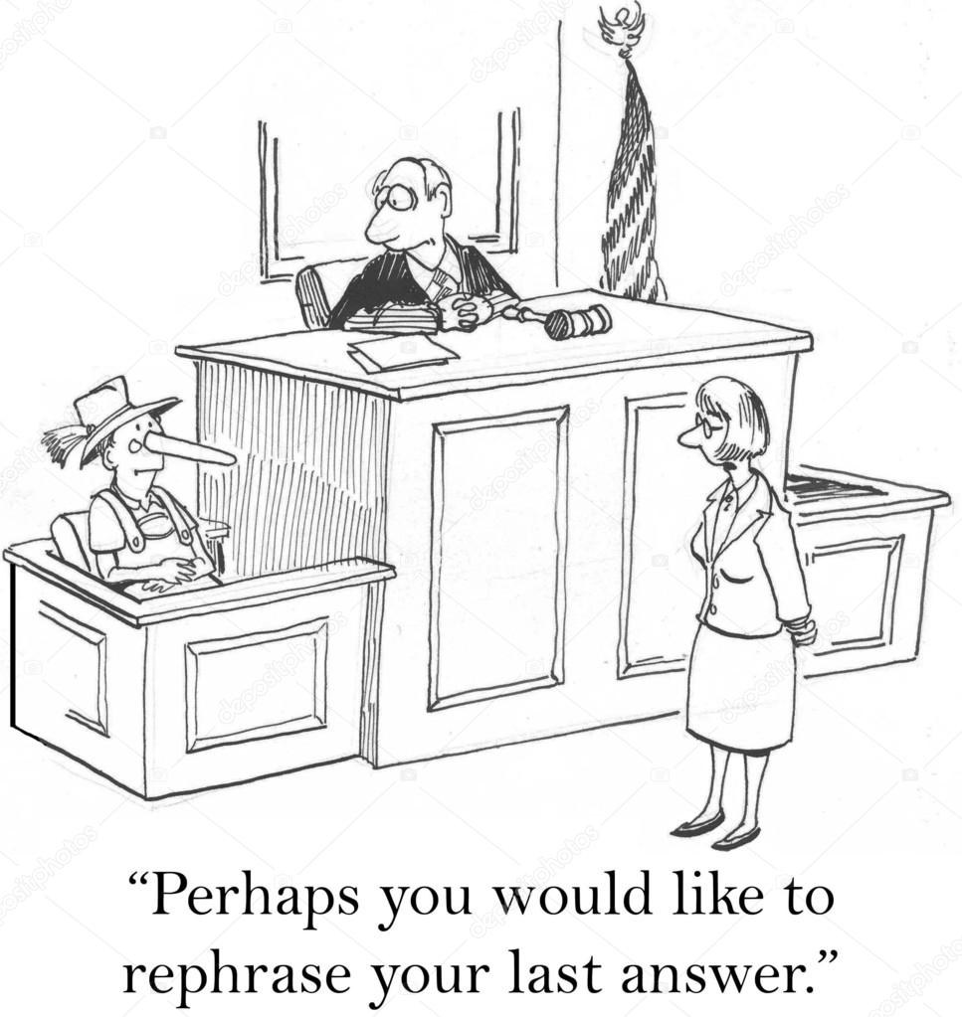
What is a Moot?
Simulated court hearing
Prepare legal arguments
Formal conversation NOT debate

Slide 6
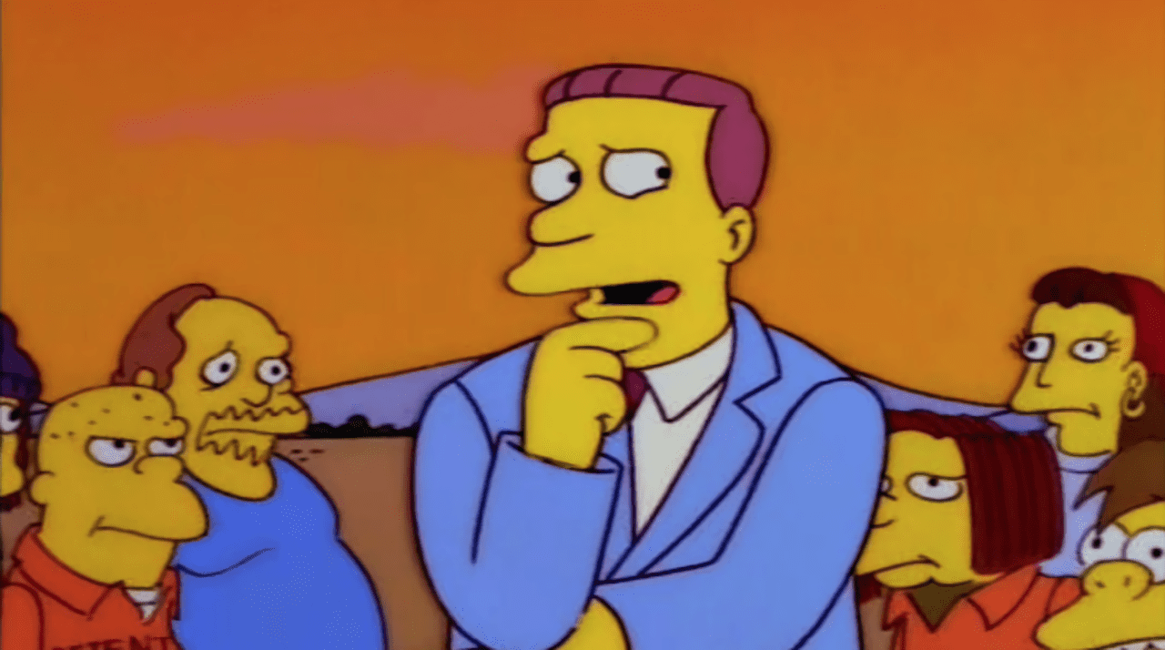
Why participate in mooting?
Engage with interesting and topical legal issues
1
Enhance advocacy and writing skills
2
Collaborate with peers
3

Slide 7

Who can participate?
Must be studying Year 11 or 12 Legal Studies
Student at Sunshine Coast high school
Teams must be comprised of:
  2 – 5 competitors per team
  Students from the same high school
  Coach (teacher, parent or community member)

Slide 8
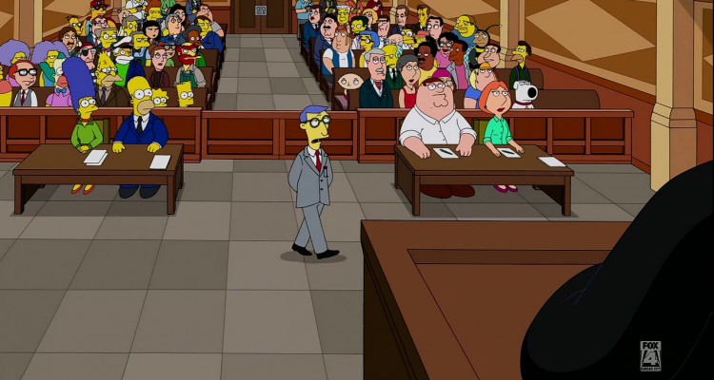
What to expect
Research
Teamwork
Time Management
Courage and humility
Resilience
Support

Slide 9

Important Resources
THE MOOT PROBLEM!!!

Slide 10
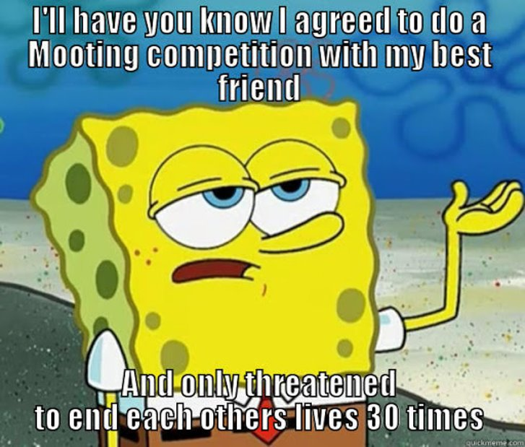
How to choose a team…
Mooting requires teamwork
Team members need to be able to work together
A team of 3 might work better than a team of 5 in some cases
Teams could be all year 11, all year 12 or a mixture
At least 3 team members means there is a backup speaker
All team members should be prepared to speak!

Slide 11
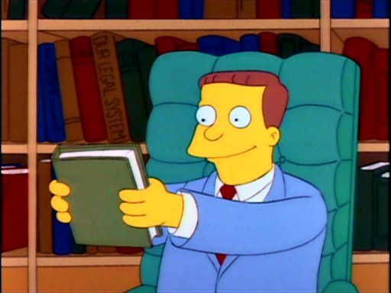
Other important resources
Coach
Librarian
Legal Studies teacher
Parent/ Guardian
Australian Legal Dictionary and other law textbooks
Mooting Convenors

Slide 12
Coaching
What is the Coach’s role?
What is NOT the coach’s role?
To support team
Research guidance
Assist team to understanding concepts
Basic proof reading
Liaise with Mooting Convenors
Timekeeping (if required)
To write submissions for the team!

Slide 13

How to start writing
Know the scenario and the law
Using the law, work out the issues
Do extra reading/research
Once you have the issues, go back to the law
Re-read the scenario over and over
Don’t forget – you will be preparing both sides of the case

Slide 14
Organising your submissions
Start with your strongest submission if possible
Allow for alternative arguments (but make that clear)
Example:
  Firstly, when Fred struck George, it was not unlawful.
  Secondly, even if it was unlawful, Fred may rely on self-defence to justify his actions.

Slide 15
Written Submissions
Submissions to be supported by authorities (legislation or case law)
Make numbered submissions
Use headings
Use Australian Guide to Legal Citation but NO FOOTNOTES

Slide 16

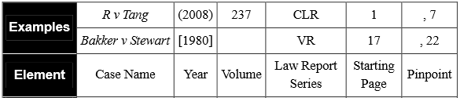
Referencing

Slide 17
Writing style
Write in plain English
Be succinct
Ensure your style is consistent
Proof read

Slide 18
Written Submissions
You will be mooting for both Prosecution and Defence – you will need written submissions for each
Example provided in the Competition Rules
PROOF READ
Bring three copies of submissions for judges in each round (stapled)

Slide 19
Electronic filing
Send your submissions electronically. A shared folder will be provided for your team (details to be provided)
Teams will not receive the opposing team’s submissions until they have submitted their own.
Late submissions lose 5% of available marks per day they are late.
Due by 5:00pm on due dates – time on email is the time submitted

Slide 20
Marking Criteria – written submissions
Criteria | Particulars
Knowledge and understanding of legal issues | Coverage of legal issues raised in the case; demonstrates an understanding of the legal issues; makes reasoned and logical arguments.
Accurate selection of primary sources | Uses prescribed case law and legislation appropriately.
Referencing and citations | All legal principles acknowledged where appropriate and all citations set out in the submissions according to the Australian Guide to Legal Citation including pinpoint references.
Presentation and Grammatical Conventions | Uses appropriate language; structure and presentation appropriate to Supreme Court of Queensland submission; free from spelling and grammatical errors; complies with competition rules.

Slide 21

Improving your written submissions
You will receive feedback after each preliminary round
  Marked score sheet only
Feedback provided to coach’s email address
You may change your submissions after each round
For finals rounds, you do not need to submit revised submissions
  If you don’t submit revised submissions, the previous submissions will be used.
  If you do submit revised submissions, they will be marked again but you will not receive feedback until the end of the competition.

Slide 22
Oral submissions
Mooting is a conversation
Advocates need to persuade the judges
Any team member can make oral submissions
Advocates can change between rounds

Slide 23

Before the moot
Arrive early!
Expect to be nervous.
Ensure all team members are ready to step in if needed.
Last minute check of personal presentation.
Make sure you locate a clock.
Have a pen/s and paper.
Three copies of written submissions for judge.
Have spare copies of all notes, submissions etc.

Slide 24
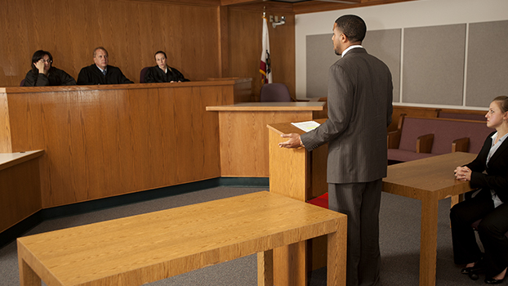
Where to sit?
Judges (1 – 3)
Prosecution/Appellant
Defendant/Respondent

Slide 25
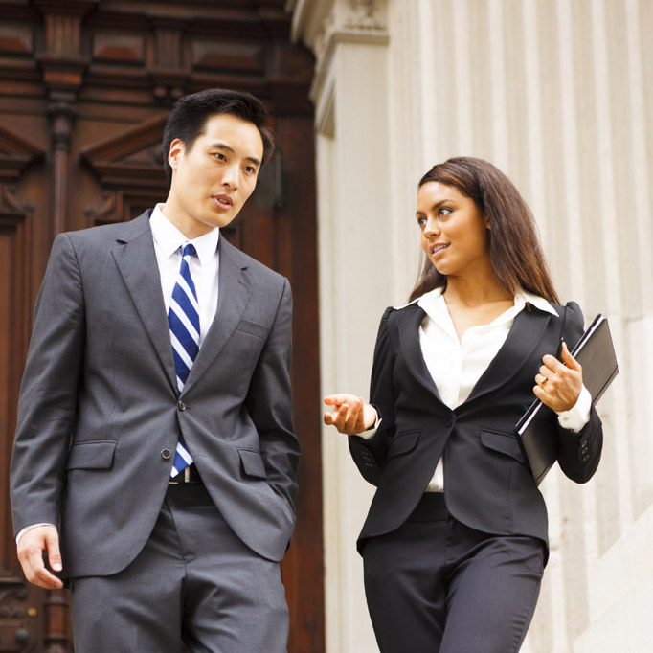
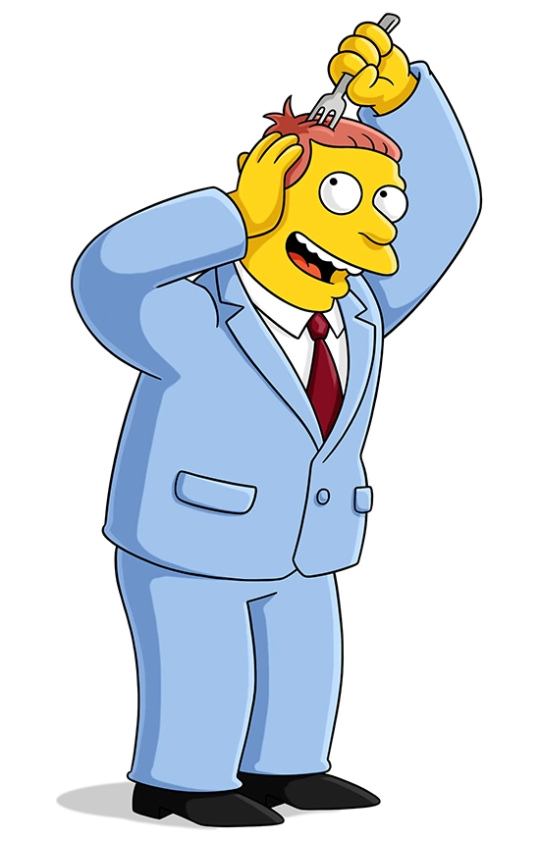
Presentation
“Suit up” – smart dress code
Hair tied back
Formal school uniforms are acceptable
Consistent style between team members
Be guided by your coach

Slide 26
Starting a Moot
Stand up when judge enters room.
Judge bows – everyone bows to judge.
When judge sits, everyone can sit.
Judge asks for appearances.
Senior Counsel for Defendant announces their appearance.
Senior Counsel for Prosecution announces their appearance.
Moot commences with Prosecution’s submissions.

Slide 27
Appearances
Appearances are an introduction to your team.
Each team will have a Senior Counsel and Junior Counsel.
  Other team members may sit at the bar table (space permitting)
Senior Counsel introduces both counsel.
Eg: “May it please the Court, my name is Leon Harris and I appear with my learned colleague Ben Princehorn for the prosecution/defendant in this matter. I will be speaking for 12 minutes and my junior counsel will be speaking for 8 minutes.”
  LEARN THIS VERBATIM

Slide 28
Order of Speaking
Appearances
Senior Counsel for Prosecution
Junior Counsel for Prosecution
Senior Counsel for Defence
Junior Counsel for Defence
NO right of reply
If this changes, the mooting problem will make this clear.

Slide 29
Formalities
Avoid colloquialisms such as “yeah”, “like”, “dunno” etc.
Refer to judges as “Your Honour”
Refer to opponents as your “learned friends” or as “appellant”/ “respondent”
Stand when speaking – only speak when spoken to
Do not interrupt opposing counsel’s submissions

Slide 30

During Moot
Watch the time: 20 mins/team; at least 7 mins/speaker.
Team members may communicate with each other using notes.
Competitors will be given a 1 minute warning before their time expires.
When time expires, you must stop talking.

Slide 31

Additional time
The Rules allow an additional 2 minutes of speaking time per team.
Used at the team’s discretion (ie 1 min each or 2 mins to one counsel).
You must request a time extension from the judge.
  The best time to request an extension is at the one minute warning.
  “Your Honour/s, may I please request a 2 minute extension?”
  Thank the judge when your request is granted.

Slide 32
Advocacy skills
Speak loudly, clearly, confidently and SLOWLY
Avoid reading a pre-prepared script
Know the issues and know the law
Be courteous to the judge and opposition at all times
Feel free to disagree with the judge but do so respectfully

Slide 33
Advocacy skills
Eye contact!!
Signposting
Anticipate your opponent’s arguments (respond to their submissions)
Bring the judge/s back to the submissions

Slide 34
Time Management
Prioritise material
Be flexible to deal with questions from the bench (or a silent bench!)
Move on
Use your last minute to summarise your arguments
Don’t speed up!

Slide 35
Judging
Judges could be:
  Experienced UniSC law student mooters
  UniSC academic staff
  Sunshine Coast legal practitioners
Judges may not know the scenario (or the law!) as well as you
Judges will be marking according to strict criteria

Slide 36
Marking criteria – oral submissions
Criteria | Particulars
Organisation of Presentation | Factors: logical organisation and structure; concise overview of submissions and conclusion; appropriate attention and weight given to some arguments over others; flexibility despite being taken off-topic; consistency between written and oral submissions.
Knowledge of Law and Development of Legal Argument | Factors: Knowledge of and application of the law and issues; logical, persuasive, arguments; citation of correct authorities; appropriate use of policy arguments; addresses opposing arguments in advance (appellant) or consequentially (respondent).
Questions from the Bench | Factors: Prepared for questions that can be anticipated; clear, concise and direct responses; engagement with the court’s views; composure and courtesy despite challenges to arguments; effective integration of responses with arguments; adept treatment of irrelevant questions; ability to deal with difficult and obscure questions.
Manner and Expression | Factors: Engages with the court; projects voice; articulates submissions with eloquence; use of clear and simple language; displays confidence without arrogance; eye-contact with members of the bench; courteous and formal; maintains a professional and courteous relationship with opposing counsel; correct citation of cases; appropriate use of courtroom formalities; consistent style and manner.

Slide 37
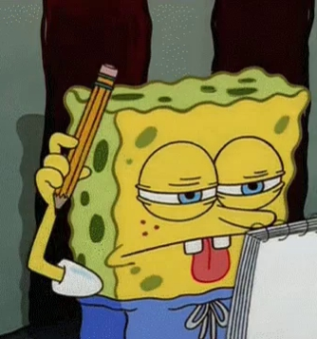
Other things to note
Competitors are not to watch other moots (unless they are no longer competing)
Family/friends are very welcome to watch moots
Watch some mooting videos on YouTube – only watch Australian university law schools

Slide 38
Registration for the moot
Schools must register teams by Friday March 22 2024
  Mooting scenario released on Friday March 22 2024 (online)
No late registrations accepted
Schools can register a team without nominating team members
  BUT coach must provide a full list of team members before the competition starts
Online registration
  https://www.usc.edu.au/connect/schools-engagement/on-campus/sunshine-coast-schools-mooting-competition

Slide 39
Competition Structure
Preliminary Rounds:
1 x Prosecution
1 x Defence
Four winning teams will progress to the semi finals
Two winning teams will progress to the grand final

Slide 40
Timetable and Deadlines
 | Date | Place/venue
Team Registration Open | Monday 4th March | Online [School Holidays between 29th March-14th April]
Team Registration Closes | Friday 22nd March | Online
Mooting Problem Released | Friday 22nd March | Online
Written Submissions due for round 1 | Monday, 6 May | By email
Opposing team’s submissions emailed | Tuesday, 7 May | By email
Preliminary Round 1 | Monday, 13 May | SCGS or Unity College
Feedback for Round 1 Submissions | Tuesday, 14 May | By email
Written Submissions due for round 2 | Monday, 20 May | By email
Opposing team’s submissions emailed | Tuesday, 21 May | By email
Preliminary Round 2 | Monday, 27 May | SCGS or Unity College
Feedback for Round 2 Submissions | Tuesday, 28 May | By email
Written Submissions Due (if submitting updated version) (Semi Finals) | Thursday, 30 May | By email
Opposing team’s submissions emailed (Semi Finals) | Friday, 31st May | By email
Semi Finals | Monday, 3 June | University of the Sunshine Coast, Moot Court, JG15
Written Submissions Due (if submitting updated version) (Grand Finals) | Thursday, 6 June | By email
Opposing team’s submissions emailed (Grand Finals) | Friday, 7 June | By email
Grand Finals | Monday, 10 June | University of the Sunshine Coast, Moot Court, JG15

Slide 41

Important resources
Information Booklet

Slide 42
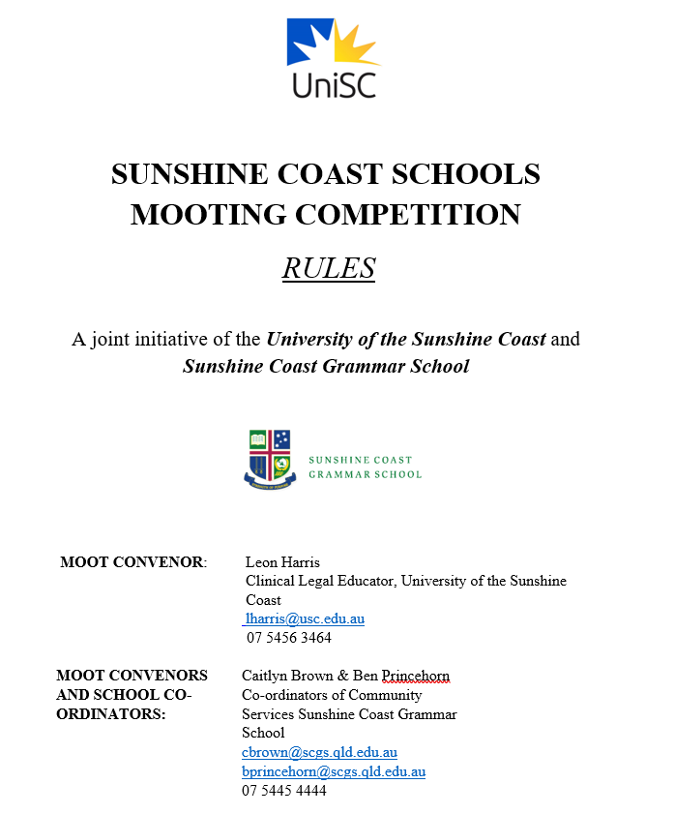
Important resources
Competition rules

Slide 43
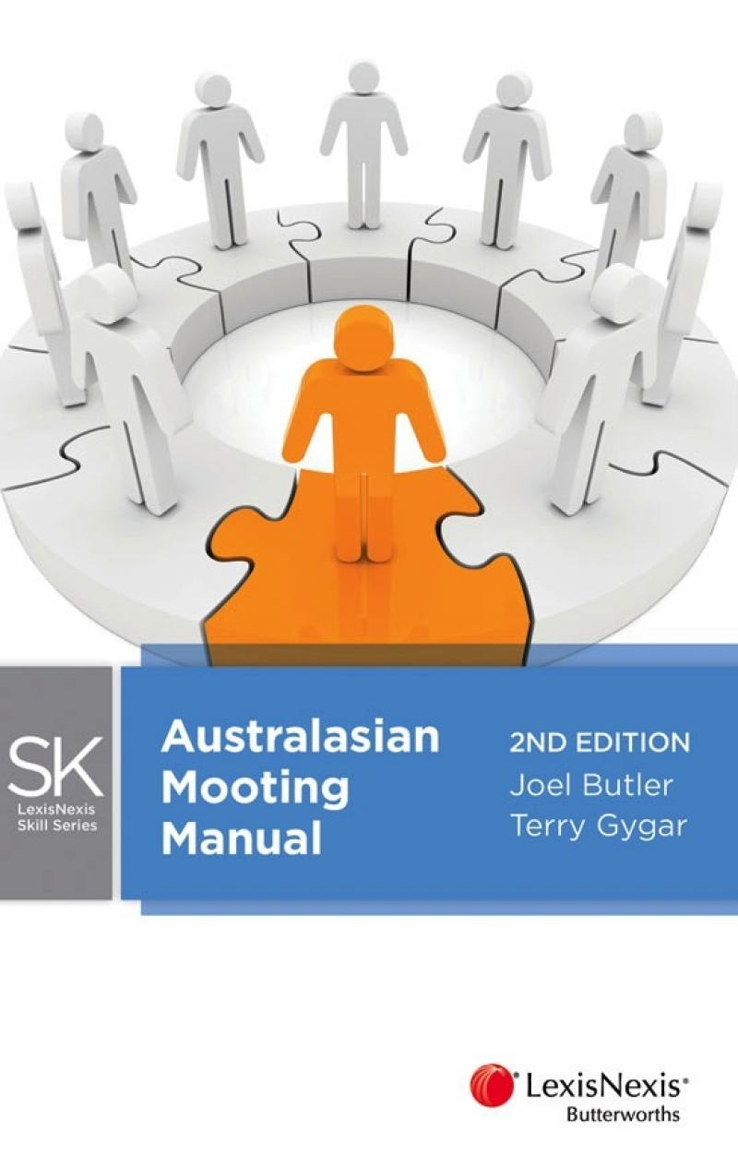
Important Resources
Textbook:
Joel Butler and Terry Gygar, Australasian Mooting Manual (LexisNexis, 2nd ed, 2012)

Slide 44
Awards
Competition Champion Award
Tournament Runner-Up Award
Best Written Submissions Award
Best Speaker Award
Winners announced at Grand Final!

Slide 45
Questions?
Ask your coach
Contact us: lharris@usc.edu.au
Answers to all pertinent questions will be forwarded to all coaches

